Slide 1
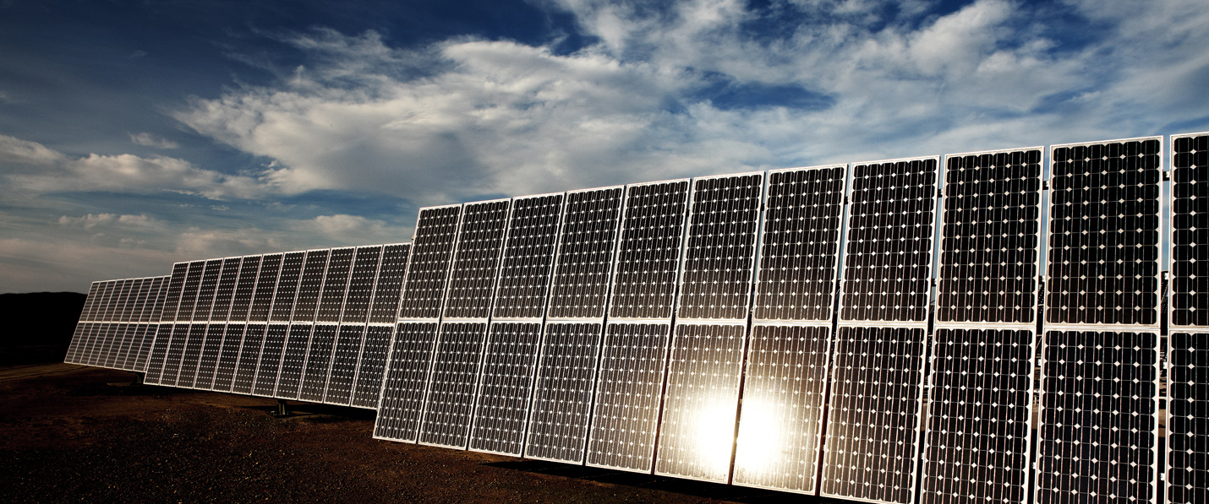
Cloud Tracking & Solar Forecasting for PV Power Prediction Project Update
Luis Domínguez, CH.RD.C1, August 30, 2013

Slide 2
Briefing
Project Update
Project Status
Project Plan
Technical Progress
VISMO operation & issues encountered
Cloud Motion Estimation
GHI clear sky prediction
PV power output prediction
Next Activities

Slide 3
Work Breakdown Structure
Cloud Tracking
Prototype Development
(WP 1)
Algorithmic Development
(WP 2)
IP Strategy
(WP 3)
PV Power Output Modeling (WP 4)
Irradiance Forecasting
Cloud Motion Estimation and Classification
Technical Documentation
& Reporting (WP 6)
Hardware
Software
Validation & Testing
(WP 5)
Work Package
Tasks

Slide 4
Project Plan
Progress Up to Date

Slide 5
Cloud Tracking & Solar Forecasting for PV Power Prediction Prototype Operation & Issues
Luis Domínguez, CH.RD.C1, August 30, 2013

Slide 6
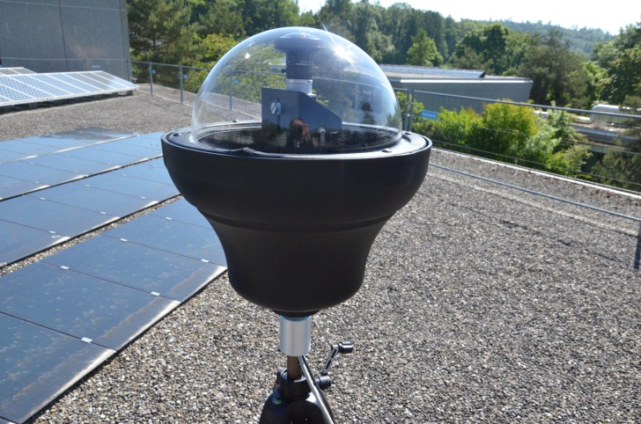
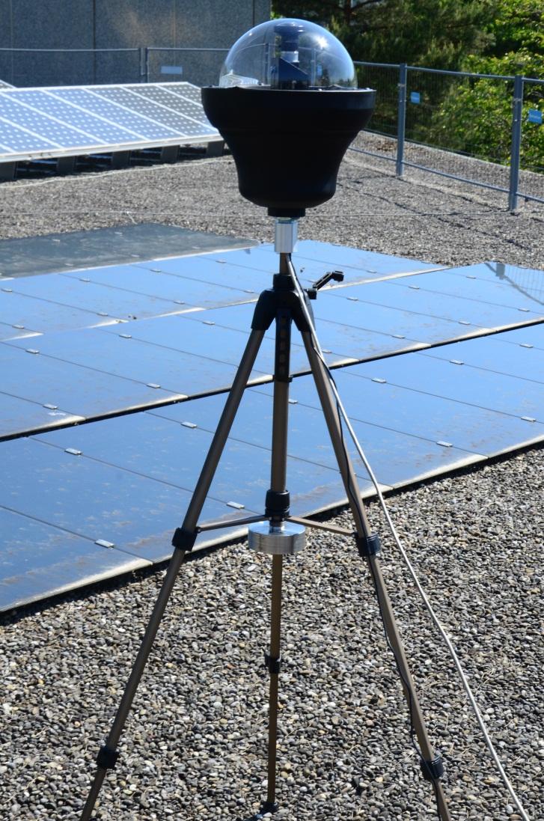
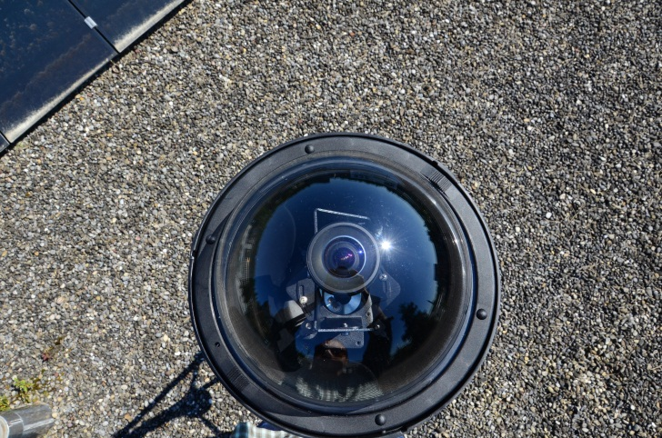
VISMO Prototype
Initial Tests 5.06.2013

Slide 7
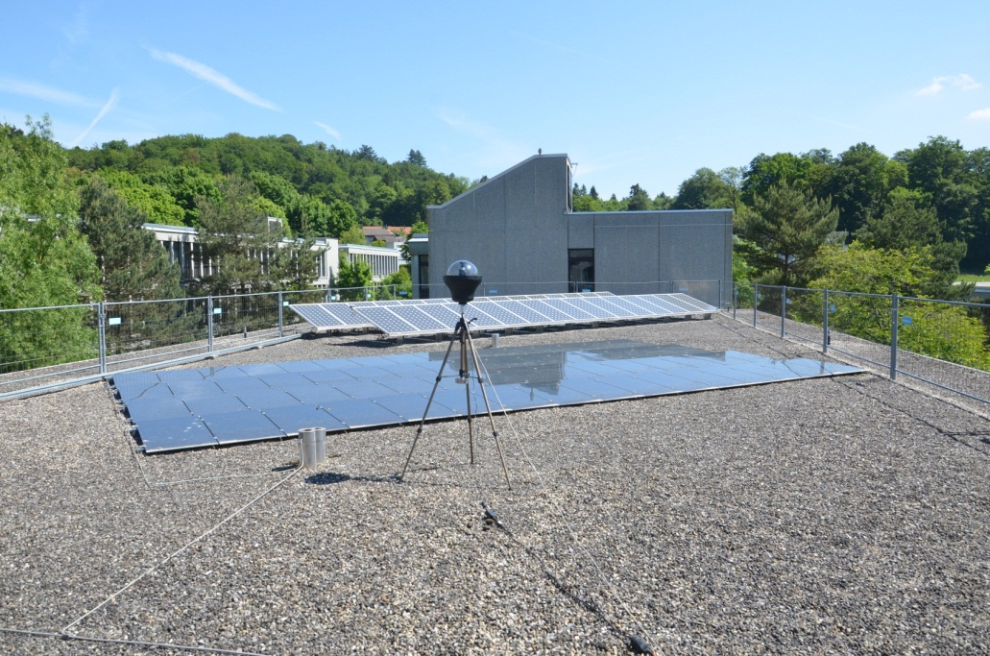
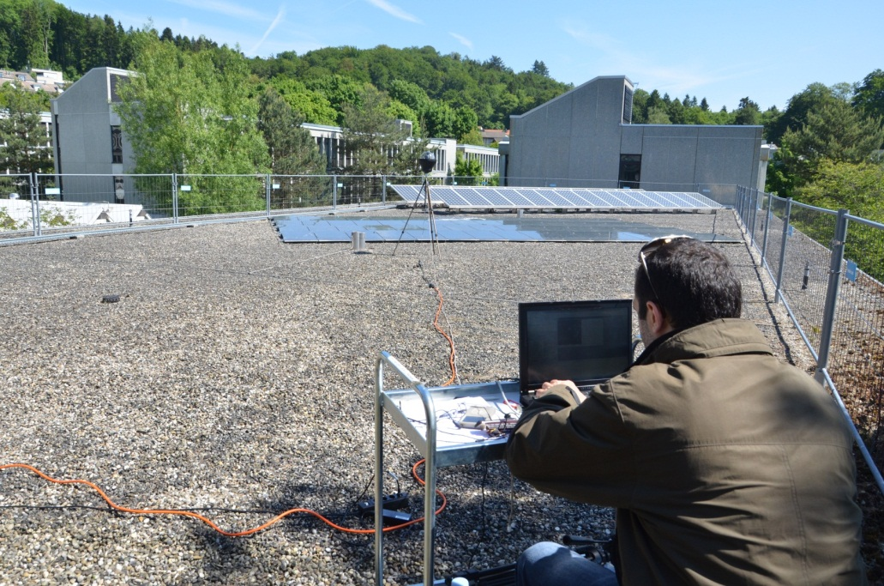
VISMO Prototype
Initial Tests 5.06.2013

Slide 8
VISMO Prototype
Issue – Enclosure Overheating
Camera w/o Paraffin
Camera (with Paraffin included)
Enclosure
w/o Paraffin
Camera operating temperature range
Enclosure (with Paraffin included)

Slide 9
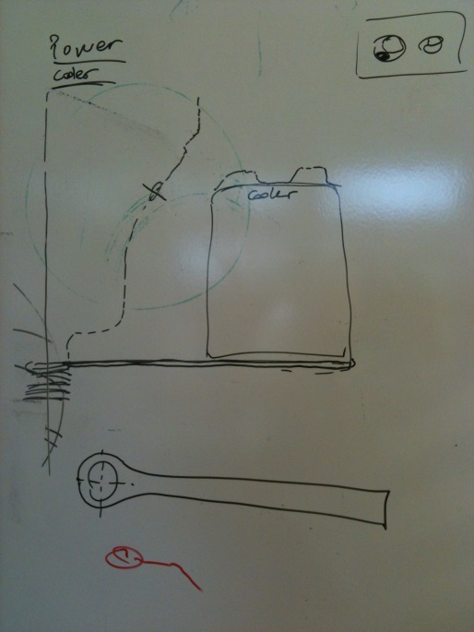
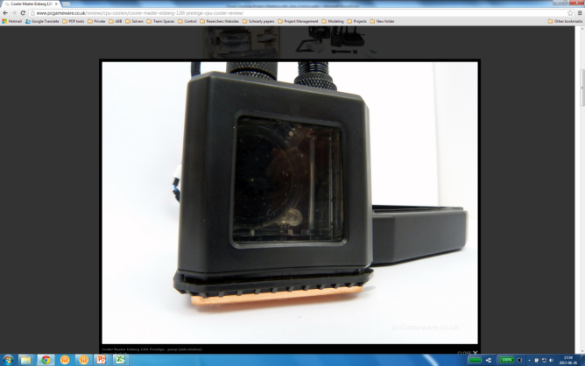
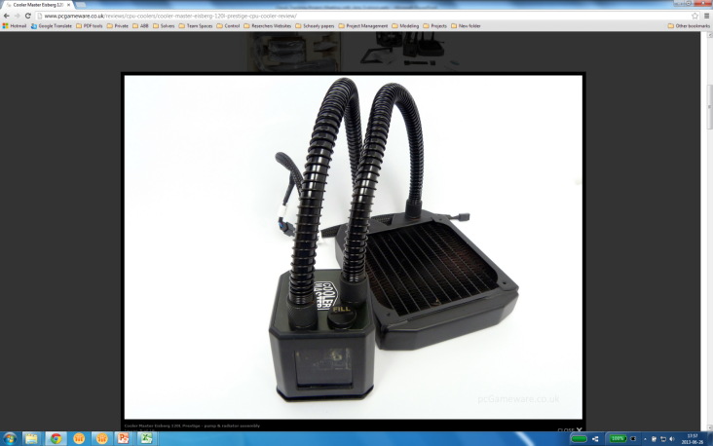
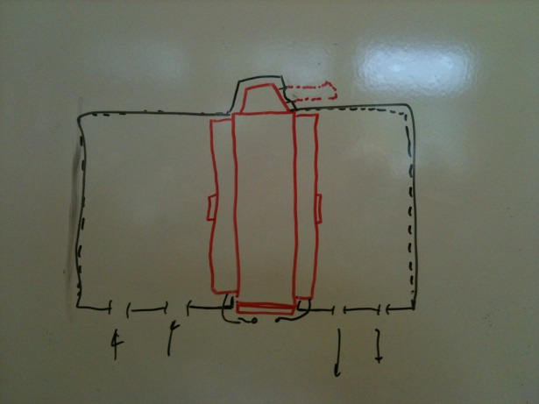
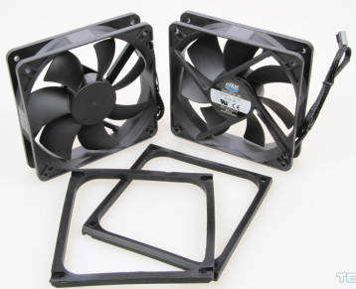
VISMO Prototype
Cooling System Design
Cooler Master Eisberg 120L Prestige
Suction Case
Liquid CPU Cooler
Pump volume: 400 Liters/hr.
Pump rotor speed: 3600 rpm @12VDC
Fan speed: 1600 rpm
Support plate
Suction Funnel
Fans

Slide 10
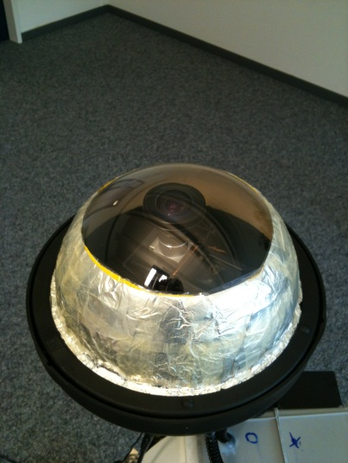
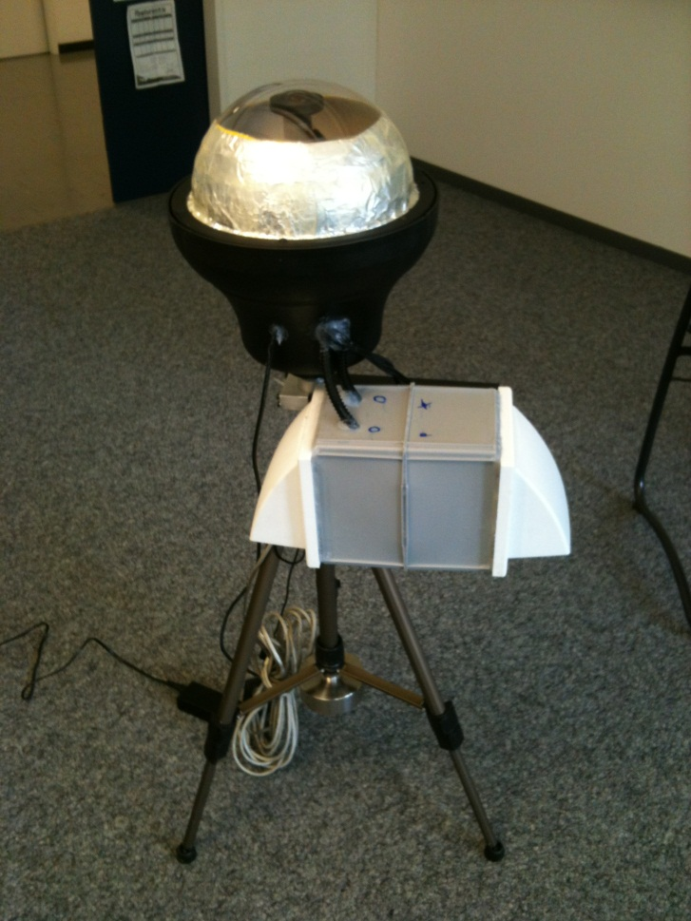
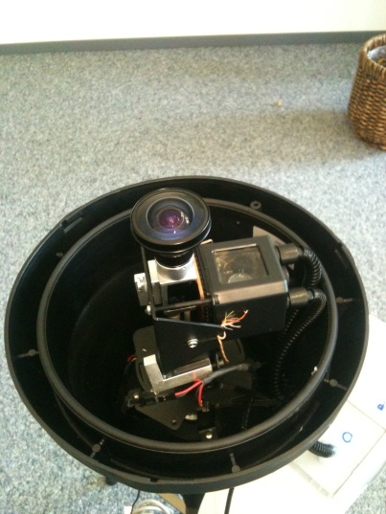
VISMO Prototype
+ Cooling System

Slide 11
VISMO Prototype
Camera Temperature Control

Slide 12
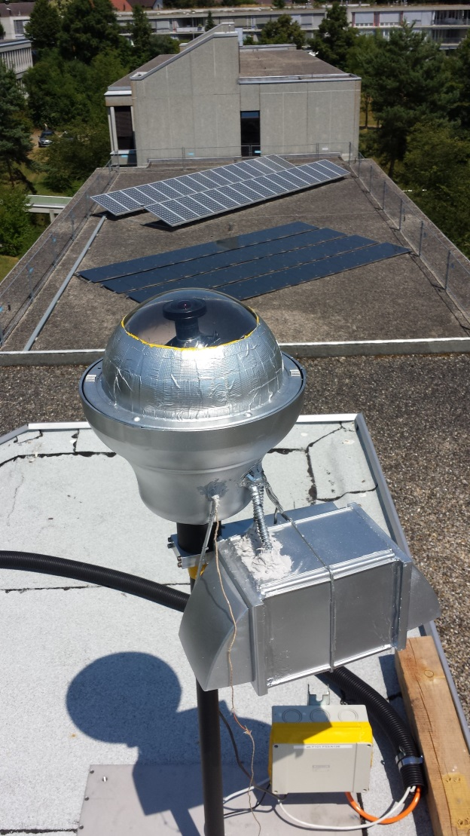
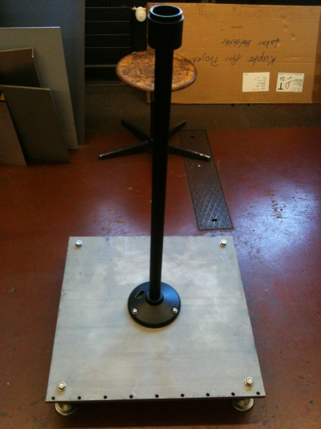
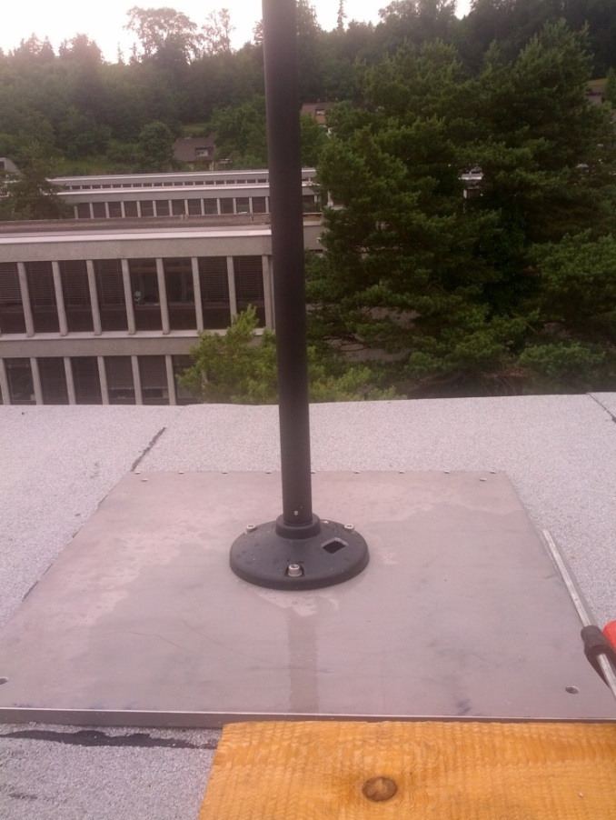
VISMO Prototype
Roof Installation on 22.07.2013

Slide 13
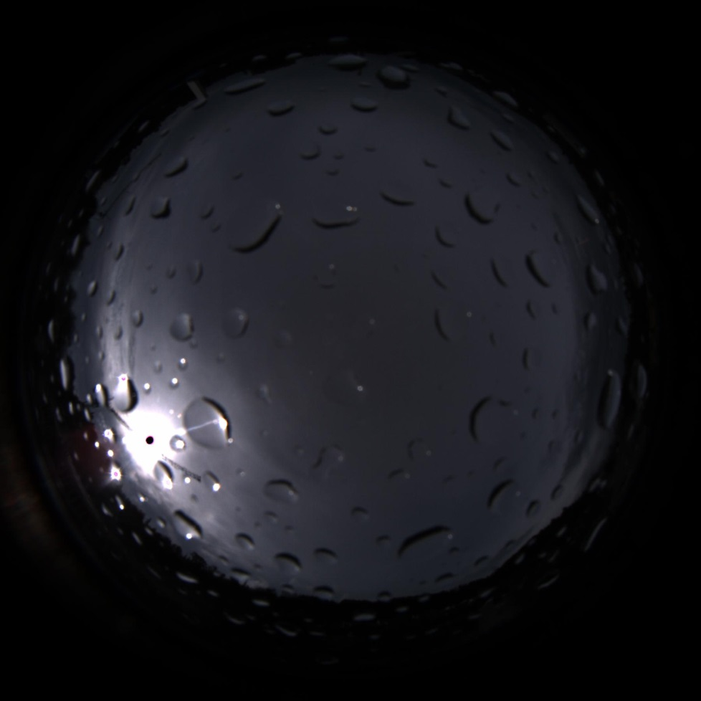
VISMO Prototype
Issue 2 – Water leakage inside camera case
26. July 2013:
Water inside the prototype and also between case walls and upper spherical glass cover.
Condensation droplets were detected on images after heavy rain.

Slide 14

VISMO Prototype
Issue 2 – Water leakage inside camera case
31. July 2013:
The water was removed and the prototype was dried.
Hypothesis was that cooling water from pump was leaking. However, cooling pump water level seemed ok, indicating leakage was only due to bad weather.

Slide 15
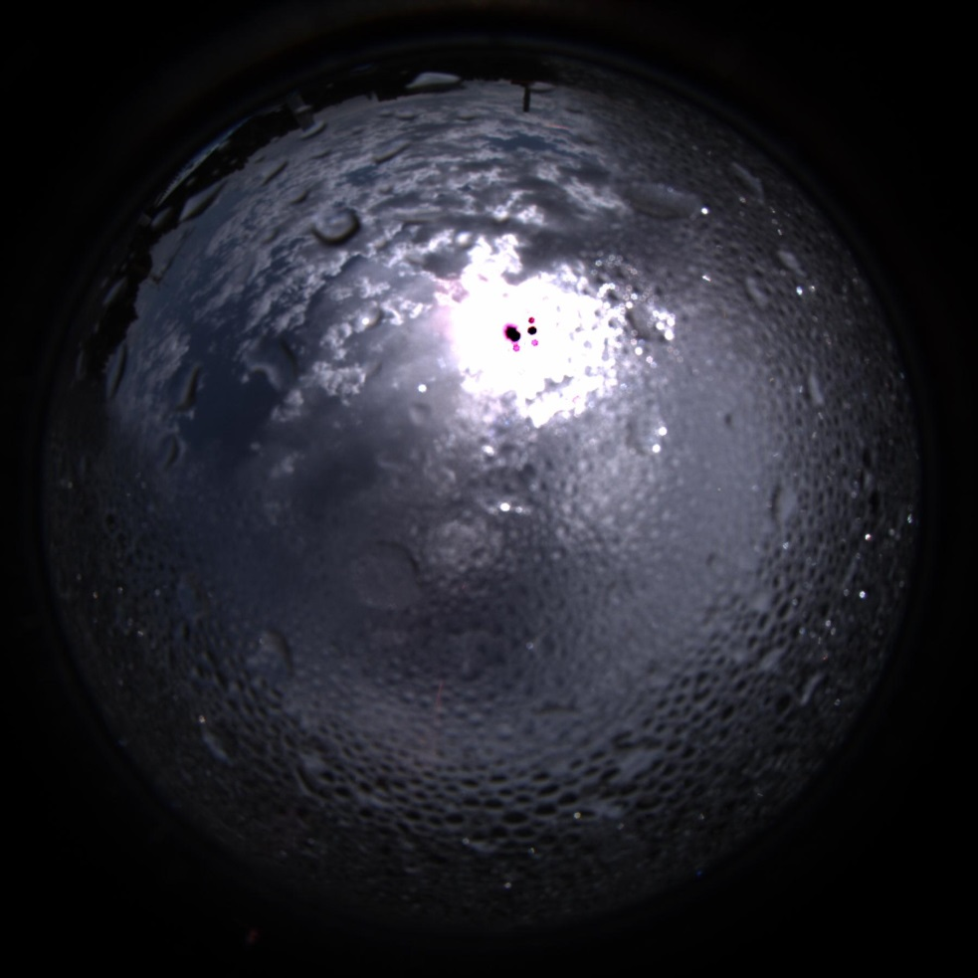
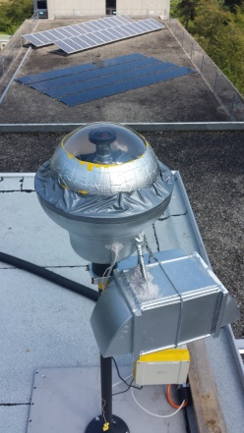
VISMO Prototype
13. August 2013:
The water was again removed from the space between the case walls and the upper spherical glass cover.
Cover was taped to the base body of the case to make the contact Waterproof.
The cooling pump water level seemed ok.

Slide 16
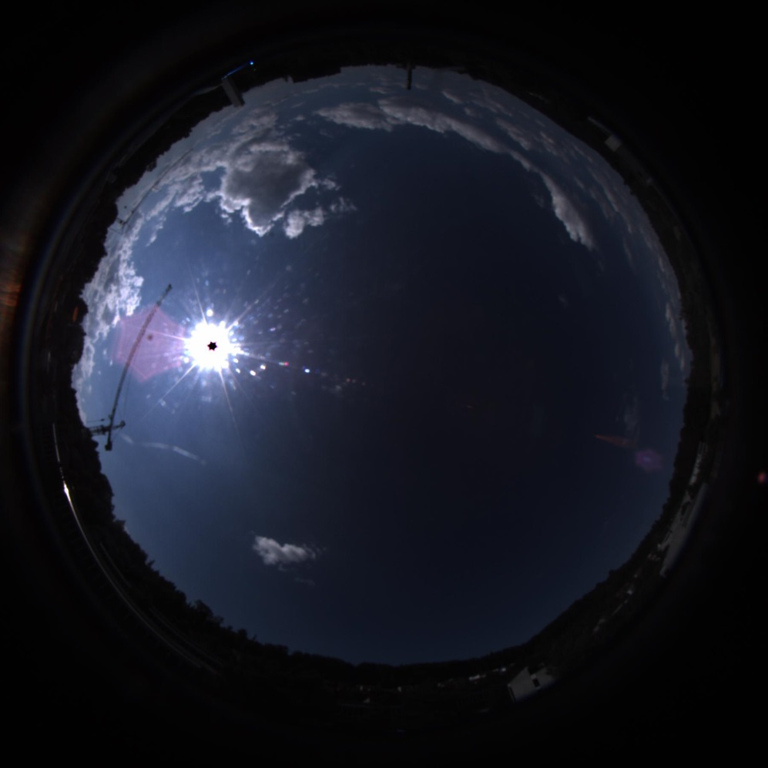
VISMO Prototype
16. August 2013
Problem seems to be solved. No condensation droplets are visible on the images.
Currently monitoring images.

Slide 17
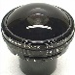
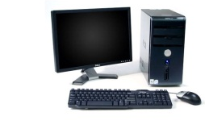
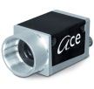
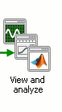

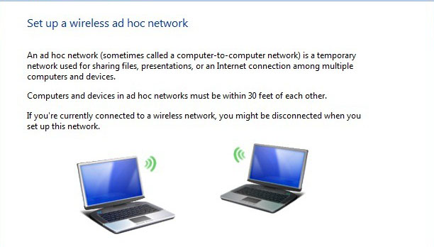
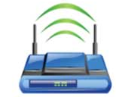
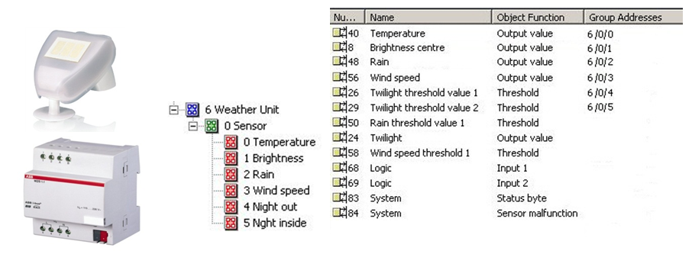
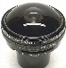

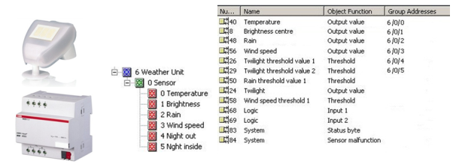
VISMO Prototype
Network Configuration Issue
Direct (Local) Connection
Network (Remote) Connection
Forecast
Cloud Motion Estimation & Irradiance Forecasting
VISMO
LAN
Cloud Motion Estimation & Irradiance Forecasting
VISMO
KNX weather station
(WZ / S 1.1, WES / A 2.1)
KNX weather station
(WZ / S 1.1, WES / A 2.1)
Notes:
Image acquisition is
as a multi-threaded architecture. Stores the captured images on a network hard drive. Can also store in a database if required

Slide 18
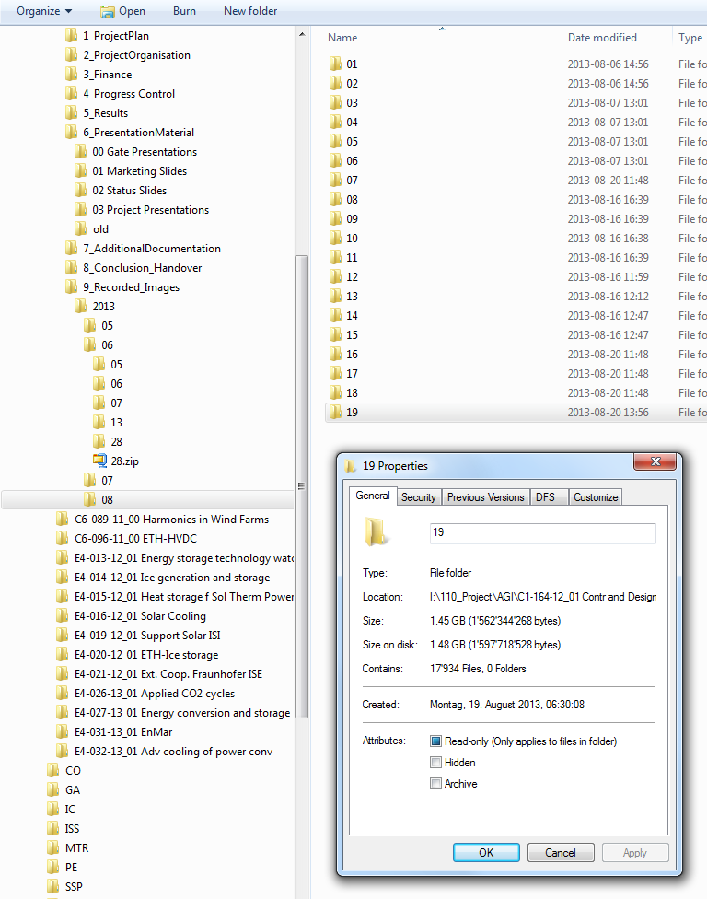
VISMO Prototype
Network Configuration Issue
Database size is rapidly increasing. Images are taking up large space on laptop hard drive. These have been temporarily moved to project folder.
Potential solution: buy an external hard drive and to use it only for storing images.

Slide 19
VISMO Prototype
Some Observations
In the early morning the algorithm is not working properly.
Reason: clouds are very dark, sun very bright. Detection algorithm fails to recognize clouds.
In general the resolution of the images is not so as high as expected and the images seem quite dark most of the time.
Proposed Solution: Dynamic HDR

Slide 20
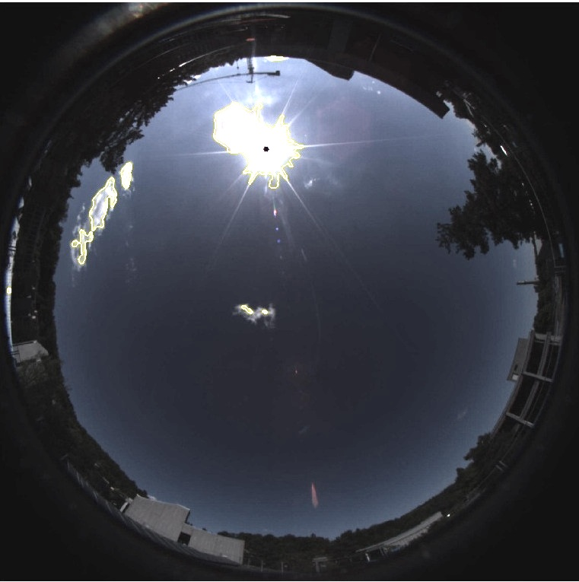
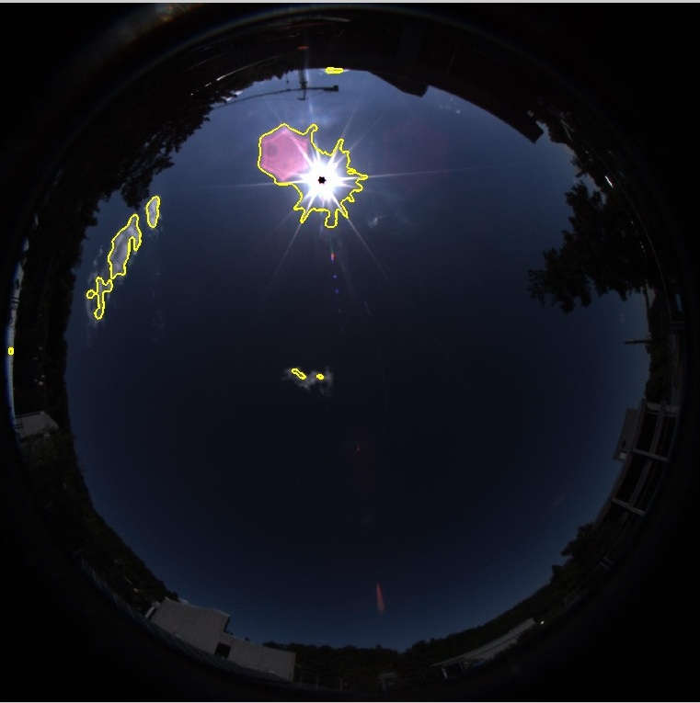
VISMO Prototype
* Procedure required to minimize sun effects.
Image Acquisition, Processing & Analysis
Raw Image
Exposure Correction*
Notes:
To deal with the impact of the sun, takes several images varying exposures, and merges them to obtain the finalized image.
On the final output, areas with and without the sun have a balanced tone. Details around the sun can easily be noticed.
The frequency with which the images are captured can be configured using this software.
Camera parameters such as exposure and sensor sensitivity can be configured.

Slide 21
Cloud Tracking & Solar Forecasting for PV Power Prediction Cloud Motion Estimation
Luis Domínguez, CH.RD.C1, August 30, 2013

Slide 22
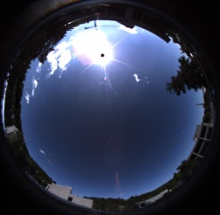
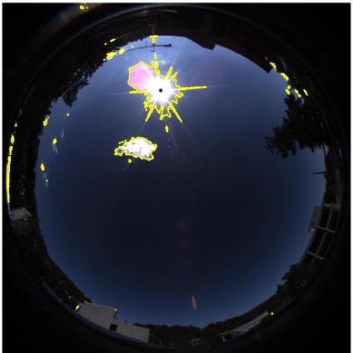
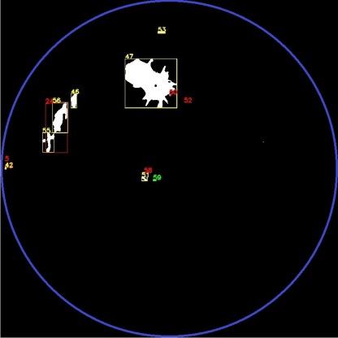
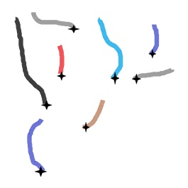
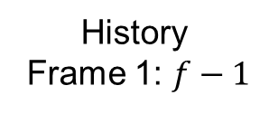
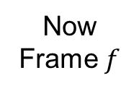
Cloud Tracking
Object Tracking on image plane
History
Frame 1: $f−1$
Now Frame $f$
Automatic detection of moving clouds in the image coming from the camera is based solely on motion.
The problem (motion-based object tracking) is divided into two parts:
Detecting the moving cloud in each frame
Associating the detections (i.e. tracks) corresponding to the same object over time.
After the assignment, we “update” Kalman filters of tracks, if necessary generate new traces and delete the outdated ones.
The predictions for next steps come from the “predict” method of Kalman filters.
Hungarian Algorithm
Object Positions
Cloud Tracks
Assignment
Notes:
In the first part (here), the detection of moving objects uses a background subtraction algorithm.
Morphological operations are applied to the resulting foreground mask to eliminate noise
Blob analysis detects groups of connected pixels, which are likely to correspond to moving objects.
The second part, the association of detections to the same object is based solely on motion.
The motion of each track is estimated by a Kalman filter.
The filter is used to predict the track's location in each frame, and determine the likelihood of each detection being assigned to each track.

Slide 23
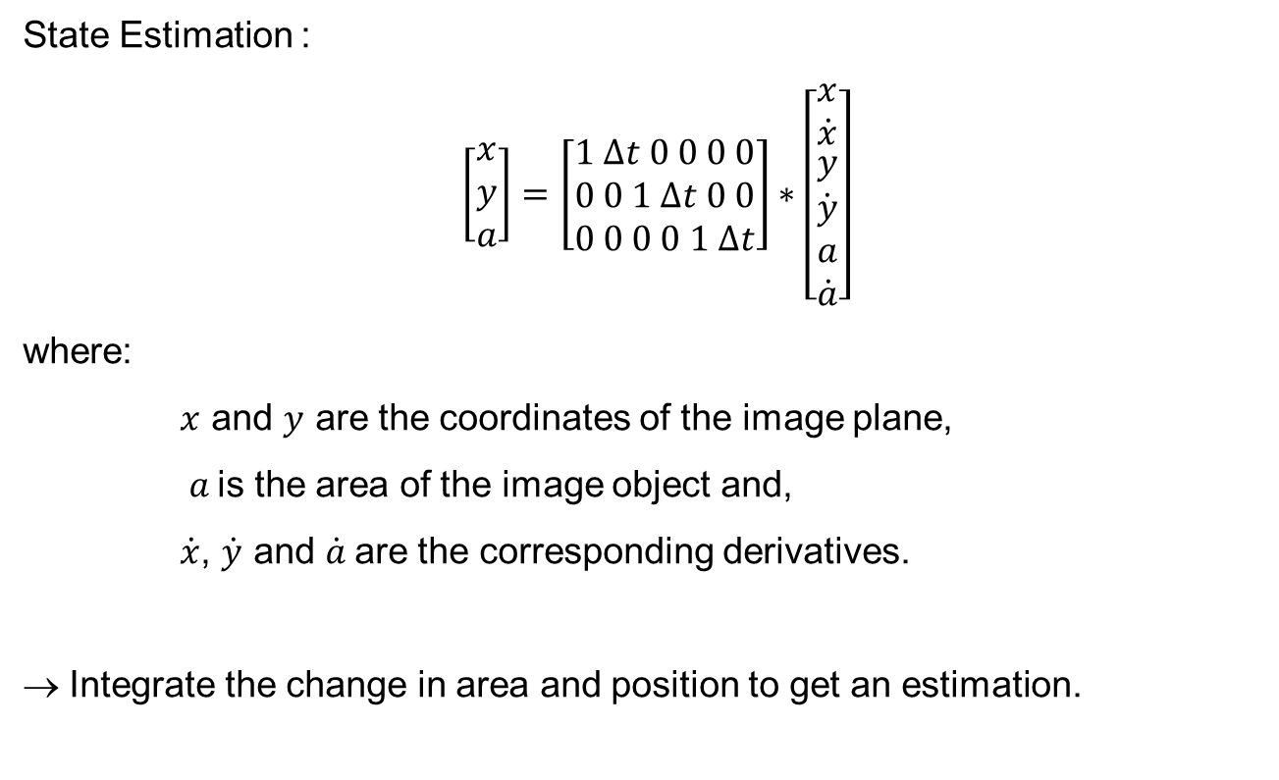
Cloud Tracking
Kalman Filter Implementation
State Estimation :
$\left[\begin{aligned}x \\ y \\ a\end{aligned}\right]=\left[\begin{aligned}1 ∆t 0 0 0 0 \\ 0 0 1 ∆t 0 0 \\ 0 0 0 0 1 ∆t\end{aligned}\right]∗\left[\begin{aligned}\begin{aligned}x \\ \dot{x}\end{aligned} \\ y \\ \dot{\begin{aligned}y \\ a \\ \dot{a}\end{aligned}}\end{aligned}\right]$
where:
$x$ and $y$ are the coordinates of the image plane,
$a$is the area of the image object and,
$\dot{x}$, $\dot{y}$ and $\dot{a}$are the corresponding derivatives.
→ Integrate the change in area and position to get an estimation.
Notes:
As I mentioned the motion of each track is estimated by a Kalman filter.
For now, we use straightforward implementation of the Kalman filter

Slide 24

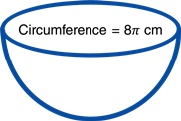
Cloud Tracking
Object Tracking - Projection to real plane
For this mapping we use the calibration model of the camera.
Calibration model provides us mapping between ‘image plane coordinates’ and ‘the coordinates on the unit circle around the camera’; and the inverse.
We train this model using a chessboard with a standard procedure.
Later use it to project the cloud pixels on the image plane onto a plane with real dimensions in km’s that is parallel to earth.
In parallel we do all the tracking work on this real plane as well.
Unit sphere around camera
Real-dimension model plane
Mapping
Image Plane
Notes:
So far I have talked about tracking the clouds on an image plan, to obtain the predictions in real coordinates we nee to use a calibration model for the camera.
Calibration model provides us with a mapping between ‘image plane coordinates’ and ‘the coordinates on the unit circle around the camera’; and the inverse.

Slide 25
VISMO Prototype
Some Observations (running various image streams)
Cloud object bounding box implementation of the current version of cloud tracking algorithm does not capture the fineness needed for prediction of an occlusion.
Several cloud shapes (especially if there is a high cloud cover) are not represented well enough. The square approximation covers for example 90% of the whole area. (see next slide)
Potential Solution: track movements of cloud fronts («corners») near the sun, e.g. front coming towards the sun
Sun and clouds appear often inside the same object. Once a cloud passed over the sun the object separates into 2 objects.
Potential solution. Separation of objects into sun & clouds. A sun detection/tracking algorithm needs to be implemented
Notes:
The bottleneck at the moment is the missing cloud motion prediction and its translation into GHI predictions for specific points on the ground. This will be the hardest part.

Slide 26
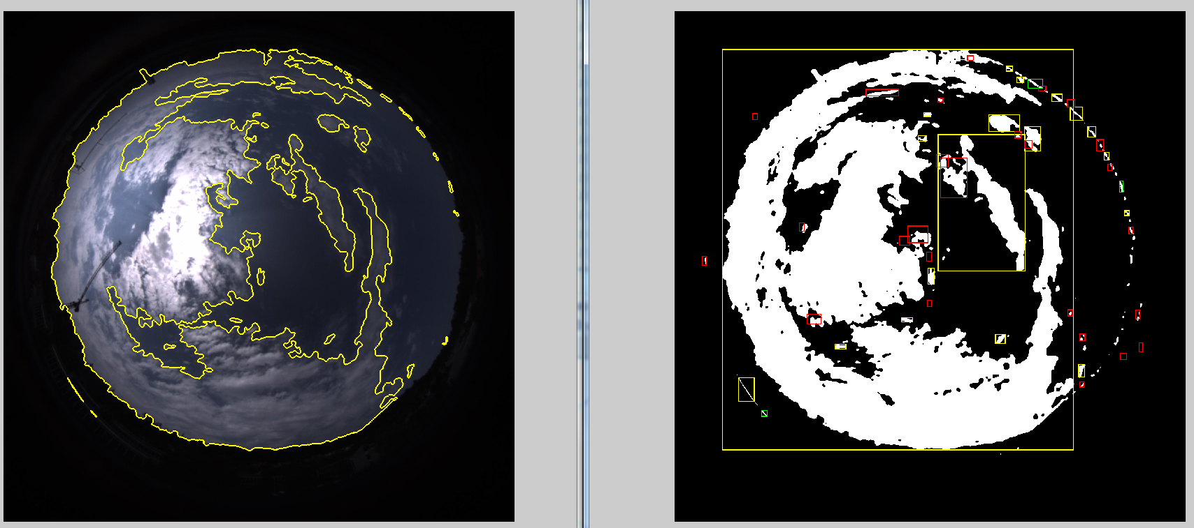

Vision Prototype
Some Observations (running 2013/07/28)
Image read: 2013_07_28_15_14_36_468.jpeg

Slide 27
Cloud Tracking & Solar Forecasting for PV Power Prediction GHI Prediction
CH.RD.C1, August 28, 2013

Slide 28
GHI Prediction
Clear Sky Model Selection
The PV_LIB Toolbox for Matlab, developed at Sandia National Laboratories. Tool mainly used for simulating the performance of photovoltaic energy systems.
Includes several Irradiance and Atmospheric functions:
Extraterrestrial incident radiation
Standard altitude based on air pressure
Average atmospheric pressure
Absolute airmass
Clear sky global horizontal irradiance models
Haurwizt (GHI)
Ineichen (GHI,DNI, and DHI)

Slide 29
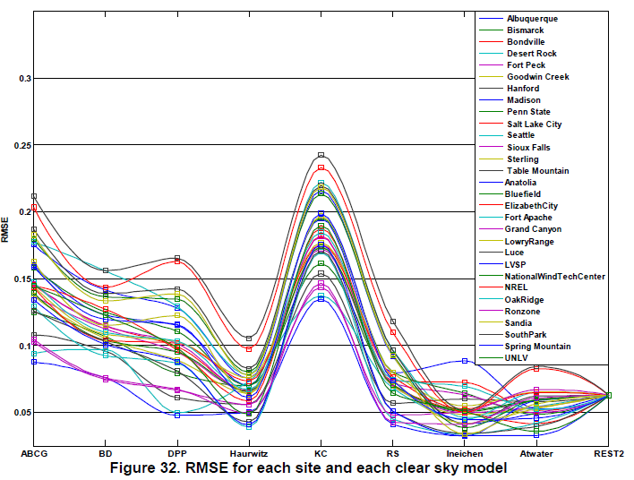
GHI Prediction
Clear Sky Model Selection
Reno et al¹ evaluated several clear sky models using a large set of data (300 years) and 30 different sites.
The analysis of clear sky models indicate that there is a trade-off between model complexity and implementation simplicity or practicality of obtaining input data.
The REST2 and the Ineichen models account for many of the atmospheric parameters are most accurate with an average RMSE of 5 % among several locations.
¹Global Horizontal Irradiance Clear Sky Models: Implementation and Analysis. Sandia Report, SAND 2013-23389, March 2012.
Notes:
This figure shows that a model with large errors at one site is also likely to have large errors at other sites, and conversely, more accurate models tend to be more accurate at each site, and that the overall accuracy of a clear-sky model is generally summarized by the average error over many sites. However, model accuracy depends fairly strongly on site elevation, with very simple models being less accurate at higher elevations.

Slide 30
GHI Prediction
Clear Sky Model Selection
REST2 is a complex two-band model requiring a large number of atmospheric parameters, such as station pressure, ground albedo, aerosol optical depth, albedo reduced ozone vertical path lenght, Angstrom’s turbidity, etc.
Ineichen model relies on a gridded dataset (look up table) that varies by month and location, but the model does not need other site-specific data, so is easy to implement.
Haurwitz model is also a simple model and is easy to implement but its performance is found to be lower than Ineichen.
In conclusion, the Ineichen model was selected for predicting GHI in clear sky conditions.

Slide 31
GHI Prediction
Adaptation of Clear Sky Model to Data
Why?
Poorly calibrated sensors may report systematically low readings.
The Largest error between clear sky models and measured data can come from sensor calibration issues (i.e. miscalibration) or from incorrect clear sky constants such as altitude.
The clear sky model will provide the shape (irradiance curve) that is expected in each day for the location in which the data was collected .

Slide 32
GHI Prediction
Adaptation of Clear Sky Model to Data
Automatic detection of clear sky days
Computation of statistics (criteria) over a moving windows of data points.
Irradiance average
Maximum irradiance value
Length of line connecting the points in the time series
Variance of slope
Maximum deviation of slope
The identification of a data scaling factor (α).

Slide 33
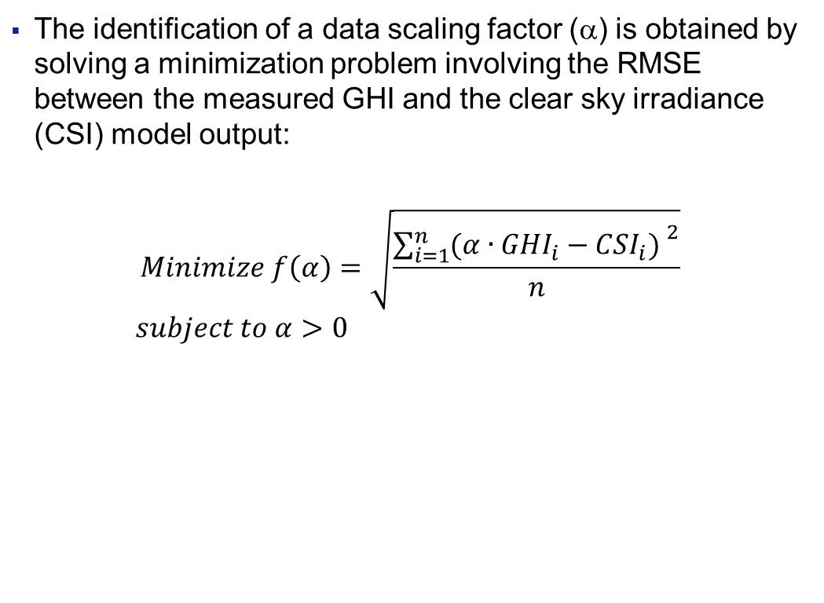
GHI Prediction
Adaptation of Clear Sky Model to Data
The identification of a data scaling factor (α) is obtained by solving a minimization problem involving the RMSE between the measured GHI and the clear sky irradiance (CSI) model output:
$$Minimize f\left(α\right)=\sqrt{\frac{{\sum_{i=1}^{n}{(α∙{GHI}_{i}−{CSI}_{i}) }}^{2}}{n}}$$
$$subject to α>0$$
Input Data (GHI)
Detect Clear Sky Times
Fit Model to Clear times
Scaling Coefficient (α)

Slide 34
GHI Prediction
Clear Sky Model
Data
Clear Sky (Ineichen)

Slide 35
GHI Prediction
Clear Sky Model
Data
Scaling Factor:
Clear Sky (Ineichen)
α = 0.9264
Identified Clear Sky Data

Slide 36
Cloud Tracking & Solar Forecasting for PV Power Prediction PV Power Output Prediction
CH.RD.C1, August 30, 2013

Slide 37
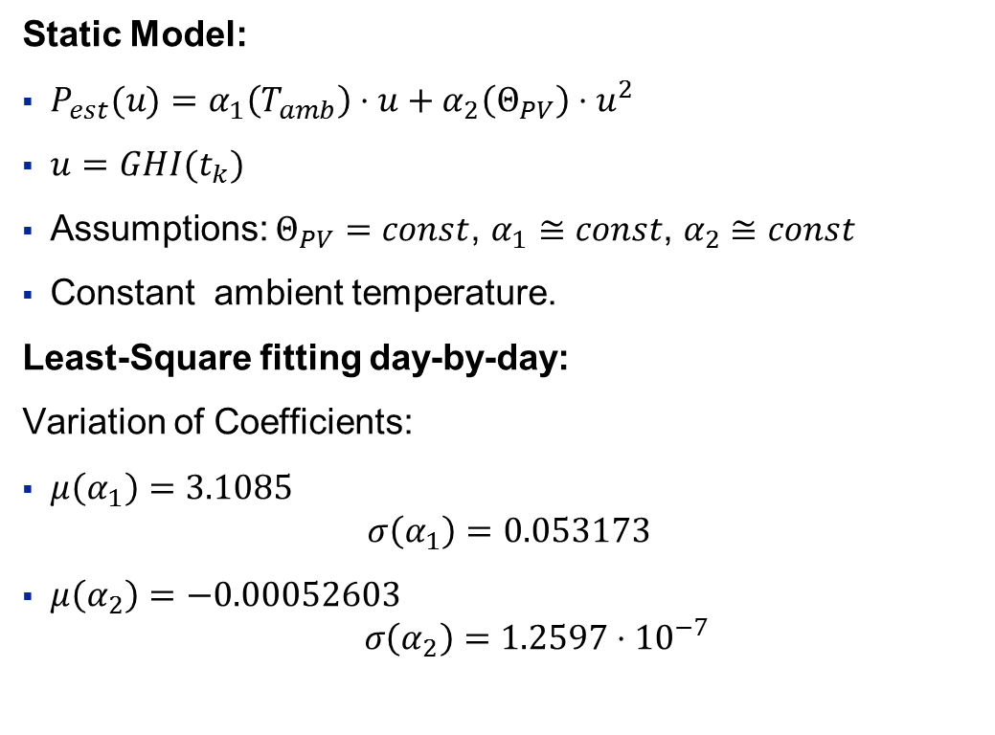
Modeling PV Power Output
Day-by-day fitting
Static Model:
$P_{est}(u)=α_{1}\left(T_{amb}\right)⋅u+α_{2}\left(Θ_{PV}\right)⋅u^{2}$
$u=GHI(t_{k})$
Assumptions: $Θ_{PV}=const$, $α_{1}≅const\text{, }α_{2}≅const$
Constant ambient temperature.
Least-Square fitting day-by-day:
Variation of Coefficients:
$μ\left(α_{1}\right)=3.1085$ $σ\left(α_{1}\right)=0.053173$
$μ\left(α_{2}\right)=−0.00052603$ $σ\left(α_{2}\right)=1.2597⋅{10}^{−7}$

Slide 38
Modeling PV Power Output
Day-by-day fitting
Clear sky day
Partially cloudy day

Slide 39
Modeling PV Power Output
Day-by-day fitting
Variable day
Very cloudy day

Slide 40
Modeling the PV Power output
Day-by-day fitting
Conclusion:
The simple model performs well, nevertheless the inaccuracy greatly increases for very variable days
Model structure seems to capture the relevant behavior
Parameter adaptation might help given an actual window of GHI and PV output data
Simple idea:
Use a KF to estimate the parameters on the past data window (e.g. 2 hours of past data)
Then assume constant parameters for the future and use the KF to predict the PV output given a GHI prediction vector (e.g. 15min)

Slide 41
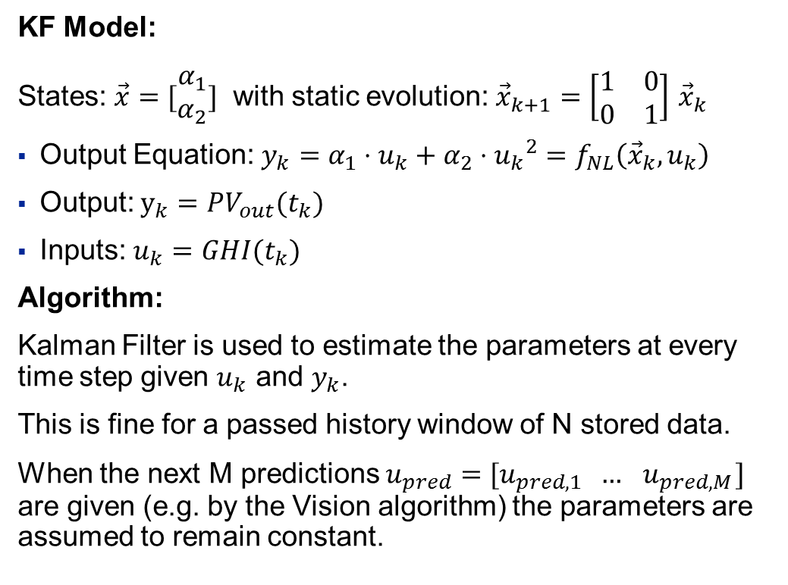
Modeling the PV Power output
Kalman Filter Approach
KF Model:
States: $\vec{x}=[\begin{matrix}α_{1} \\ α_{2}\end{matrix}]$ with static evolution: ${\vec{x}}_{k+1}=\left[\begin{matrix}1 & 0 \\ 0 & 1\end{matrix}\right]$ ${\vec{x}}_{k}$
Output Equation: $y_{k}=α_{1}⋅u_{k}+α_{2}⋅{u_{k}}^{2}=f_{NL}\left({\vec{x}}_{k},u_{k}\right)$
Output: $y_{k}=PV_{out}(t_{k})$
Inputs: $u_{k}=GHI(t_{k})$
Algorithm:
Kalman Filter is used to estimate the parameters at every time step given $u_{k}$ and $y_{k}$.
This is fine for a passed history window of N stored data.
When the next M predictions $u_{pred}=[u_{pred,1} … { u}_{pred,M}]$ are given (e.g. by the Vision algorithm) the parameters are assumed to remain constant.

Slide 42
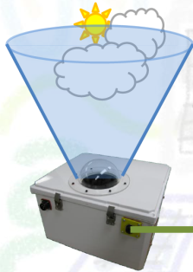
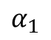
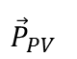
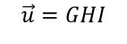



Modeling the PV Power output
Kalman Filter Approach
Algorithm:
$$α_{1}$$
Last N points
$$α_{2}$$
future
$${\vec{y}=P}_{PV}$$
$$\vec{α}$$
KF
$$\vec{u}=GHI$$
$${\vec{P}}_{PV}$$
+
+
Last N points
predicted next M points
Last N points
predicted next M points
VISMO cam
Take action
Vision Algorithm
Clear Sky GHI Model
Cloud detection Classification Motion prediction GHI Prediction

Slide 43
Modeling PV Power Output
Kalman Filter Approach
KF PV power prediction for the next 15min
Some Results:
Clear Sky forecast
Kalman Filter

Slide 44
Modeling PV Power Output
Kalman Filter Approach
«Artificial» Vision forecast
KF PV power prediction for the next 15min
Some Results:
Kalman Filter

Slide 45
Modeling PV Power Output
Kalman Filter Approach
Conclusions:
The presented approach works well and is able to predict into the future.
Once a GHI 15min forecast is available from the cloud tracking algorithm, PV power output predictions can be obtained.

Slide 46
Cloud Tracking & Solar Forecasting for PV Power Prediction Next Activities
CH.RD.C1, August 28, 2013

Slide 47



VISMO System
Overview & Target
Weather Data
PV Plant Model
PV Power Output Predictions
GHI Estimation with Cloud Tracking
Camera
GHI Drop Estimation
GHI Estimation
Image Acquisition
Cloud Tracking
Clear Sky Model
Cloud Motion Model
PV Measurement Data
Weather Data
Processed and compressed images
Shared File System
Weather Database
PV System Database

Slide 48
Next Activities
Summary
Refine object detection and localization:
Image processing part (refine size and position estimation of individual objects)
Existing solution groups all objects: sun and clouds into a single bounding box.
When cloud is close to sun, brightness of cloud is consider as the sun.
Rectangular boxes too big for estimating impact of clouds.
Object characterization (e.g. cloud features and magnitude of GHI estimation)
Take object motion prediction into account (time and partial shading effects) for GHI prediction and shadow localization.
Carry out Case Studies

Slide 49


Case Study 1
Clear Sky Days + Irradiance drop due to Fast Clouds
11:53:04
11:53:55

Slide 50
Case Study 1
Clear Sky Days + Irradiance drop due to Fast Clouds

Slide 51


Case Study 2
Overcast Days + Irradiance variation due to sky condition
11:19:13
11:46:52

Slide 52
Case Study 2
Overcast Days + Irradiance variation due to sky condition

Slide 53


Slide 54

Vision-based Sky Monitoring (VISMO) System
Project Status
Objective
To build a sky monitoring prototype system with cloud tracking and solar forecasting capabilities for improved grid operation of PV systems.
Achievements
Ramp rate analysis of PV Power Generation in CHCRC.
Identification and adaptation of a clear sky model to predict GHI clear sky days in Baden-Dättwill.
First implementation of a cloud tracking algorithm (Kalman Filter based)
Prototype test-bed has been built and is currently in operation (07/2013)
Project Value
Increase power capacity penetration of PV systems.
Smooth power generation - optimal operation via ramp rate control
Technical Challenge
Automated cloud classification requires extensive data collection (training library).
The analysis of images requires the implementation of post-processing algorithms (e.g. cloud detection, binarization and background subtraction) which may loose important information from the images. The question is how to postprocess the images without loss of iformation
Solar and cloud forecasting requires the evaluation and implementation of different type of models (e.g. clear-sky index combined with NAR, NARX models). Measurements can be used to build black-/gray-box, statistical or artificial intelligence based prediction models
Status of Project
Currently generating sky image database for advanced algorithms. Next step is to validate the system performance and iteratively improve the cloud tracking algorithm
ID submitted for review.
Issues
Hardware prototyping taking longer than expected – cooling and leaking issues
Activity new to group. Background of team is limited – extensive research and learning
Unavailability of Intern from mid July to Mid September. Burak Zeydan returns as Master’s Student.
Unavailability of project team members.
Organization & Resources
Funding program: AGI
CRID: 21174
Executing CRC: CH
Project Manager: Luis Dominguez
BU/LBU: PSPG
BU contact: Celine Mahieux
Business Case
Savings MUSD | New. rev. MUSD | NPV MUSD | IRR % | Payback years
xx | xx | xx | xx | xx
Project Financials
CF kUSD | BU kUSD | PTD kUSD | ETC kUSD | EAC kUSD
324 | xxx | xxx | xxx | xxx
Main Risks (Top 3)
High cost of components
Relative inexperience in the area of computer vision.
Resource constraints
Gate Status
IP Status
TD
IDs:
FFs:
Strategic:
0
1
2
3
4
5
6
IP comments
First Discussions
Gate 2 Concept Ready
Gate 4
Last gate: G0 / 2012
Next gate G1 / Jan 2013
G5 date: TBD
Jan/2013
April/2013
Jan/2014

Slide 55
Project
Luis: 1.0 MY Mehmet: 0.3 MY Andrea: 0.7 MY
Overview of Past and Future Activities
now
Jan 2014
Development of Algorithms
LD
GHI Clear Sky Modeling & Data Analysis
Cloud Motion Estimation & Prediction
PV Power Output Modeling
Model Integration & Validation
Fully Functional Prototype
BZ, LD, AC
AC
Ground Mapping
BZ
Data Acquisition
Matlab access code to KNX database
Image Database Generation
Future Tests
LD
BZ,LD, AC
IP Documentation & Technical Reports
Ramp Rate Analysis @ CHCRC
Test Report
LD
Presentation
VISMO Technical Option Report
ID on Cloud Tracking
IP Strategy Report
LD
LD, MM,AC

Slide 56








Clear Sky Days Identification
Irradiance average
Maximum irradiance value
Length of line connecting points in time series
Notes:
The second figures illustrates examples where the mean value of the measured time series is the same as under clear sky. Figure a is an example where the sky gradually and uniformly brightens, and Figure b shows a more realistic case where cloud enhancement originally increases the irradiance before the cloud occludes the sun. The simplest way to distinguish these conditions from clear-sky conditions is to also look at the maximum irradiance value M in the time series, which is our second criterion:
Three other criteria are proposed to more closely look at the differences between the shape of the measured irradiance timeseries and the corresponding clear sky model. Specifically, these criteria are intended to distinguish a variable time series, such as would result if clouds were present, from a smoothly changing time series.
Variability in irradiance resulting from the effects cloud cover, both large and small, will visually change the shape of the irradiance relative to a clear-sky profile. However, because cloud size, transparency and speed vary, the effects on the time series of irradiance also vary. Figure 8 shows two examples of variability in the measured data that do not change the mean and max of the timeseries. Figure 8a represents a small thick cumulous cloud, and Figure 8b represents high wispy cirrus clouds. The third, fourth and fifth criteria quantify aspects of variability in order to detect variability resulting from different types of clouds.
The third proposed criterion measures variability in irradiance by the length L of the line connecting the points in the timeseries (Eq. 60).
Any variability in the measured irradiance will increase the length of the line and be detected.
The fourth criterion is the variance of changes in the time series; specifically, the normalized standard deviation σ of the slope (x) between sequential points in the series.

Slide 57





Clear Sky Days Identification
Slope variance of series
Maximum deviation from clear sky slope
Notes:
However, the line length for a time series with a few, large changes, or with many small changes, may be similar to that of a smooth curve, necessitating additional criteria.
The fourth criterion is the variance of changes in the time series; specifically, the normalized standard deviation σ of the slope (x) between sequential points in the series. While this criterion cannot easily detect situations such as Figure 8b if the slope between measurements varies slightly, Figure 9 shows a scenario where the line lengths are the same, but the variance of slope criterion (i.e., the fourth criterion) will easily distinguish between clear and cloudy periods with these features.
The last criterion for detecting variability in the shape of the irradiance measurements is maximum deviation from clear sky slope, S . During a clear-sky period, the slope between each
measurement should be similar to the slope under a clear sky. Figure 10 shows a real example of measured GHI during and after a cloud passes over an irradiance sensor. At measurement 1, the
cloud is between the sun and the sensor, but by measurement 2, the cloud’s shadow has moved away from the sensor. Because the slope of measured GHI between observations 1 and 2 is
much larger than the slope between the corresponding clear-sky GHI values, the fifth criterion identifies the period including measurement 1 as cloudy. This last criterion ensures that
successive periods with cloud shadows occurring on the period boundaries are classified as cloudy rather than clear. The slope between measurements should not vary more than the error
for the given sensor.

Slide 58























Cloud Tracking
ABB Internal use only
Kalman Filter Improvement
Current Implementation
$$\left[\dot{\begin{aligned}x \\ \dot{y}\end{aligned}}\right]$$
$$y+\dot{y}$$
Predict
Kalman Estimation
$$y$$
$$y$$
$$x$$
$$x$$
$$x+\dot{x}$$
Frame $f$
Predict $f$+$n$
Planned Future Work
weighted average of Kalman filter and the type specific model
$$\left[\dot{\begin{aligned}x \\ \dot{y}\end{aligned}}\right]$$
Kalman Estimation
$$y+\dot{y}$$
$$y+\dot{y}$$
$$y$$
$$y$$
Type Estimation
$$y$$
$$x$$
$$x$$
$$x+\dot{x}$$
$$x$$
$$x+\dot{x}$$
Frame $f$
Prediction $f+n$
Prediction Improvement $f$+n
Confidential
Notes:
So the current implementation, we use the Kalman filter to predict the centroid of each track object in the current frame, and update its bounding box accordingly.
In a future work, we consider improving the Kalman predictions with additional information.
This can be in the form of cloud-type-specific noise parameters for the Kalman Filter, or a separate model to be superposed with the existing one.
For this, we are planning to use the database we are going to assemble to extract the statistical cloud-type-specific information.

Slide 59



Cloud Tracking
ABB Internal use only
Predicting the “time of impact” or “cloud arrival time”
Frame $f$
Predictions for frame $f$+ 10 (0.5 min)
Predictions for frame $f$+ 100 (5 min)
…
Confidential
Notes:
For the estimation of arrival time in which a cloud will start occluding the sun and project a shadow over a given PV plant we use the predictions of the tracks obtain with its corresponding Kalman filter.
and evaluating the occlusion for each step.

Slide 60





VISMO Prototype
Forecasting Strategy
Expected Output
Current sky state (clear sky, overcast, partly cloudy (scattered) cloudy (broken), etc.)
Library of sky images for training & validation of algorithm
1.- Image/data Acquisition and Processing
Cloud velocity & arrival time
Duration of drop/increase in GHI/PV output (time to cover field array)
Magnitude of drop/increase in GHI/PV output (given by the cloud characteristics such as type and brightness level)
2. Cloud Characterization and Motion Estimation
3. Irradiance Estimation
GHI estimation for current day/time
Notes:
able: Sky Condition Codes
Sky Code
Description
0 clear sky, few clouds
1 Partly cloudy (scattered) or variable sky
2 Cloudy (broken) or overcast
3 Rain
4 Fog or smoke
5 Fog or smoke
7 Snow
8 Showers (intermittent rain)

Slide 61




VISMO Prototype
Irradiance Estimation & Forecast
Data Acquisition
Processing
Learning Algorithm
Collect images
Feature Extraction
Window size (neighbours)
<> = mean of values of window centered at X.
Var() = variance of values of window centered at x
start
x
Training and Validation sets
Current Day/Time Forecast
Collect measurements
k < kmax
No
Database
yes
end
GHI Data

Slide 62
VISMO System
Continuous Monitoring:
Continuously monitor real-time measurements of irradiance and power output.
Display values of the prediction at a sampling time specified by the user (e.g. every minute).
Track the forecasting errors so as to maintain the forecasting accuracy (e.g. specified % MSE, forecasting skill index, etc.) required by the application and/or specified by the user.
Short-term Prediction:
Moving window of predictions, updated at a specified time interval (e.g. 1 to 5 min) (this is required as the errors are expected to increase as the end of horizon is approached) .
The specified horizon forecast length can vary from 10-30 min to 1 hour.
The forecasting algorithm will take into account previous forecasts (from internal or external sources), current and previous measurements as well as the errors of the predictions to refine the expected accuracy for the specified horizon.
past
future
Predicted value y(t+k│t)
Measured value y(t+k)
t-p
t-m
t-1
t
t+1
t+m
t+p
Horizon t
Moving window t
Horizon t+1
Moving window t+1
Goal: On-line Implementation of Forecast

Slide 63



VISMO Application
Ramp Control
String 1
String 2
String 3
-
P (W)
$${\overline{dP}}_{Req}$$
$$\overline{dP}≅{\overline{dP}}_{Req}$$
+
dt =1min
t (min)

Slide 64
Potential VISMO Contribution
PV/Battery Integration
Load Profile, Elec. Prices, etc.
Irradiance forecast
Other Inputs
VISMO Input
MPC
State
Parameters
Estimator
Optimizer
Model
Predicted output
Optimized Input
State
++
PV/BAT System
-+
Controlled output
Control Input
error
Process Controller

Slide 65



VISMO Application
Ramp Control
P (W)
$${\overline{dP}}_{Req}$$
$$\overline{dP}≤{\overline{dP}}_{Req}$$
String 1
String 2
String 3
dt =1min
t (min)
P (W)
$${\overline{dP}}_{Req}$$
$$\overline{dP}≤{\overline{dP}}_{Req}$$
dt =1min
t (min)

